Slide 1
Lent Week 4 Presentation

Slide 2
Trained (many) more models
Factors changed:
Number of parameters (tried simpler models)
Added log magnitude as a feature
Increased amount of data (from 16000 to 64000)
Trained with and without dropout in LSTM
Different weights in loss function

Slide 3
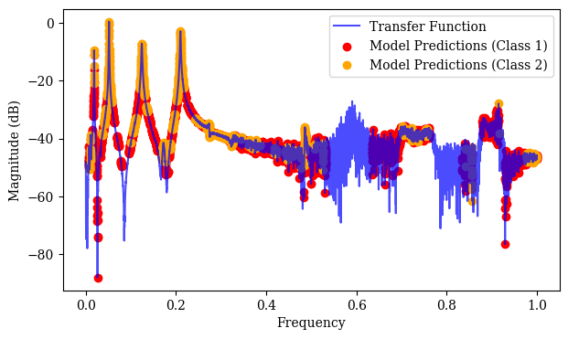
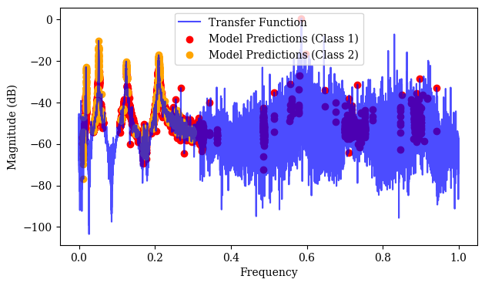
Initial performance on lab data when including log magnitude
Not great, decided to scale log magnitude feature to zero mean and unit variance. Also changed weights.

Slide 4
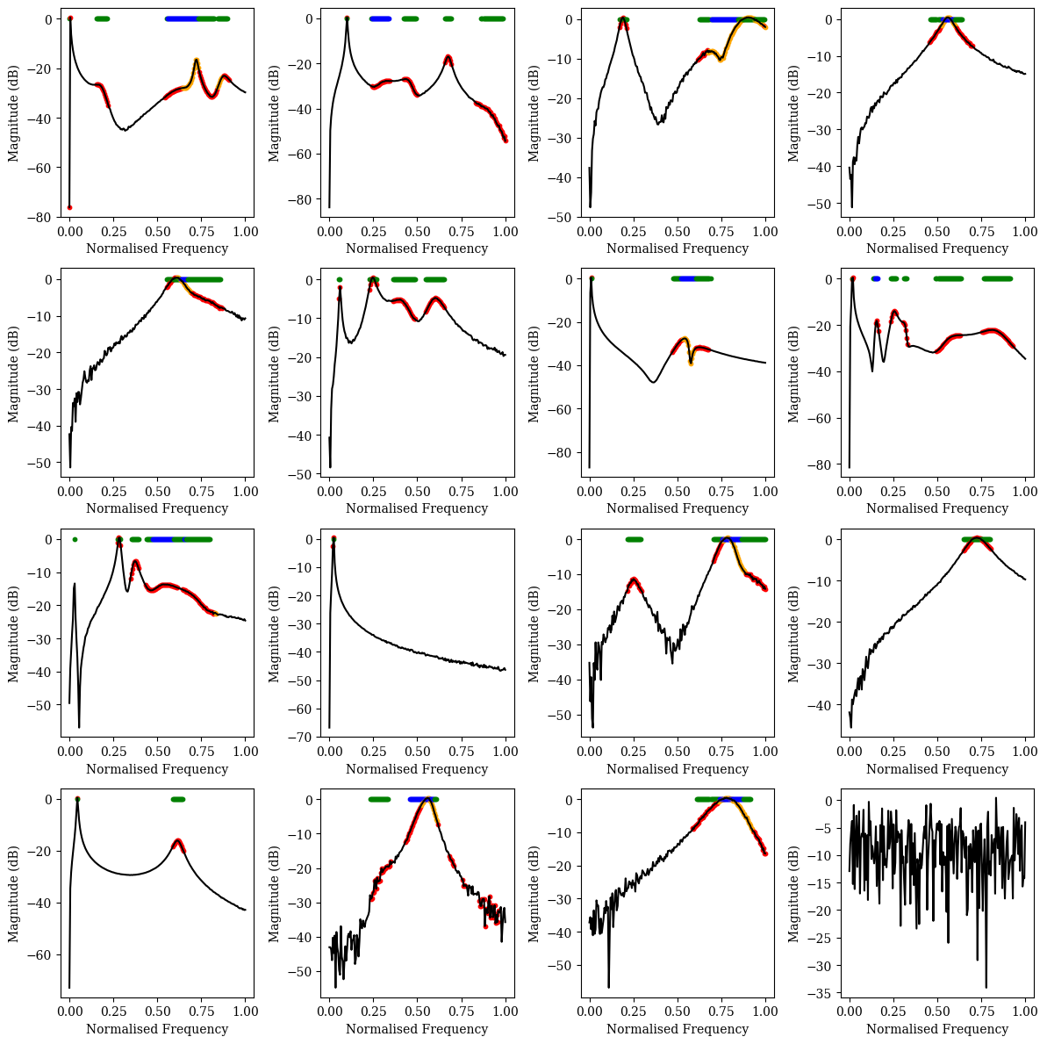
Simpler Model
Able to perform reasonably well on generated transfer functions (but with higher training and validation loss at the end of training)

Slide 5
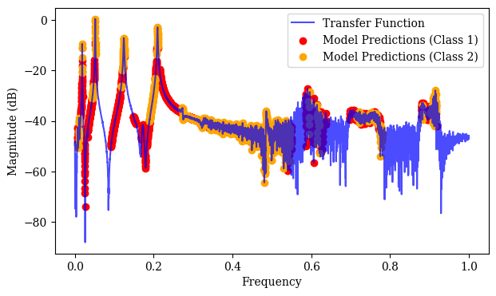
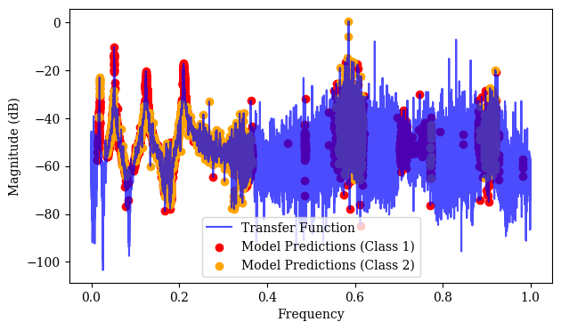
But does not perform well on lab data either – predictions in ‘bands’ in noisy region

Slide 6
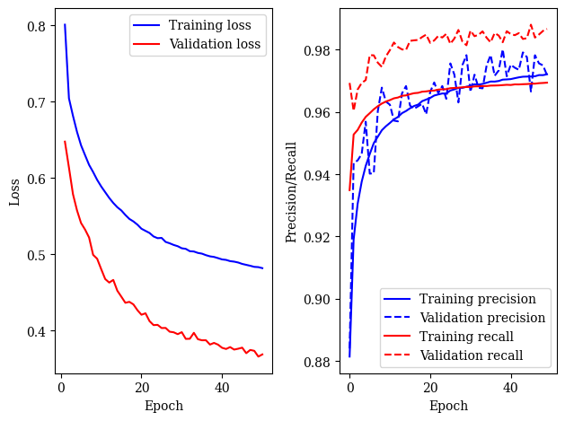
Model not overfitting so don’t think this is the issue

Slide 7
Changing other parameters did not improve performance
Seems like more complex models are able to do better (as long as they are not overfitting)
Training set not representative of real lab data??

Slide 8
Bayesian inference
Priors over modal amplitude

